Slide 1
Coin recognition using MATLAB
By:-
Rakesh.B.V
16ee137

Slide 2
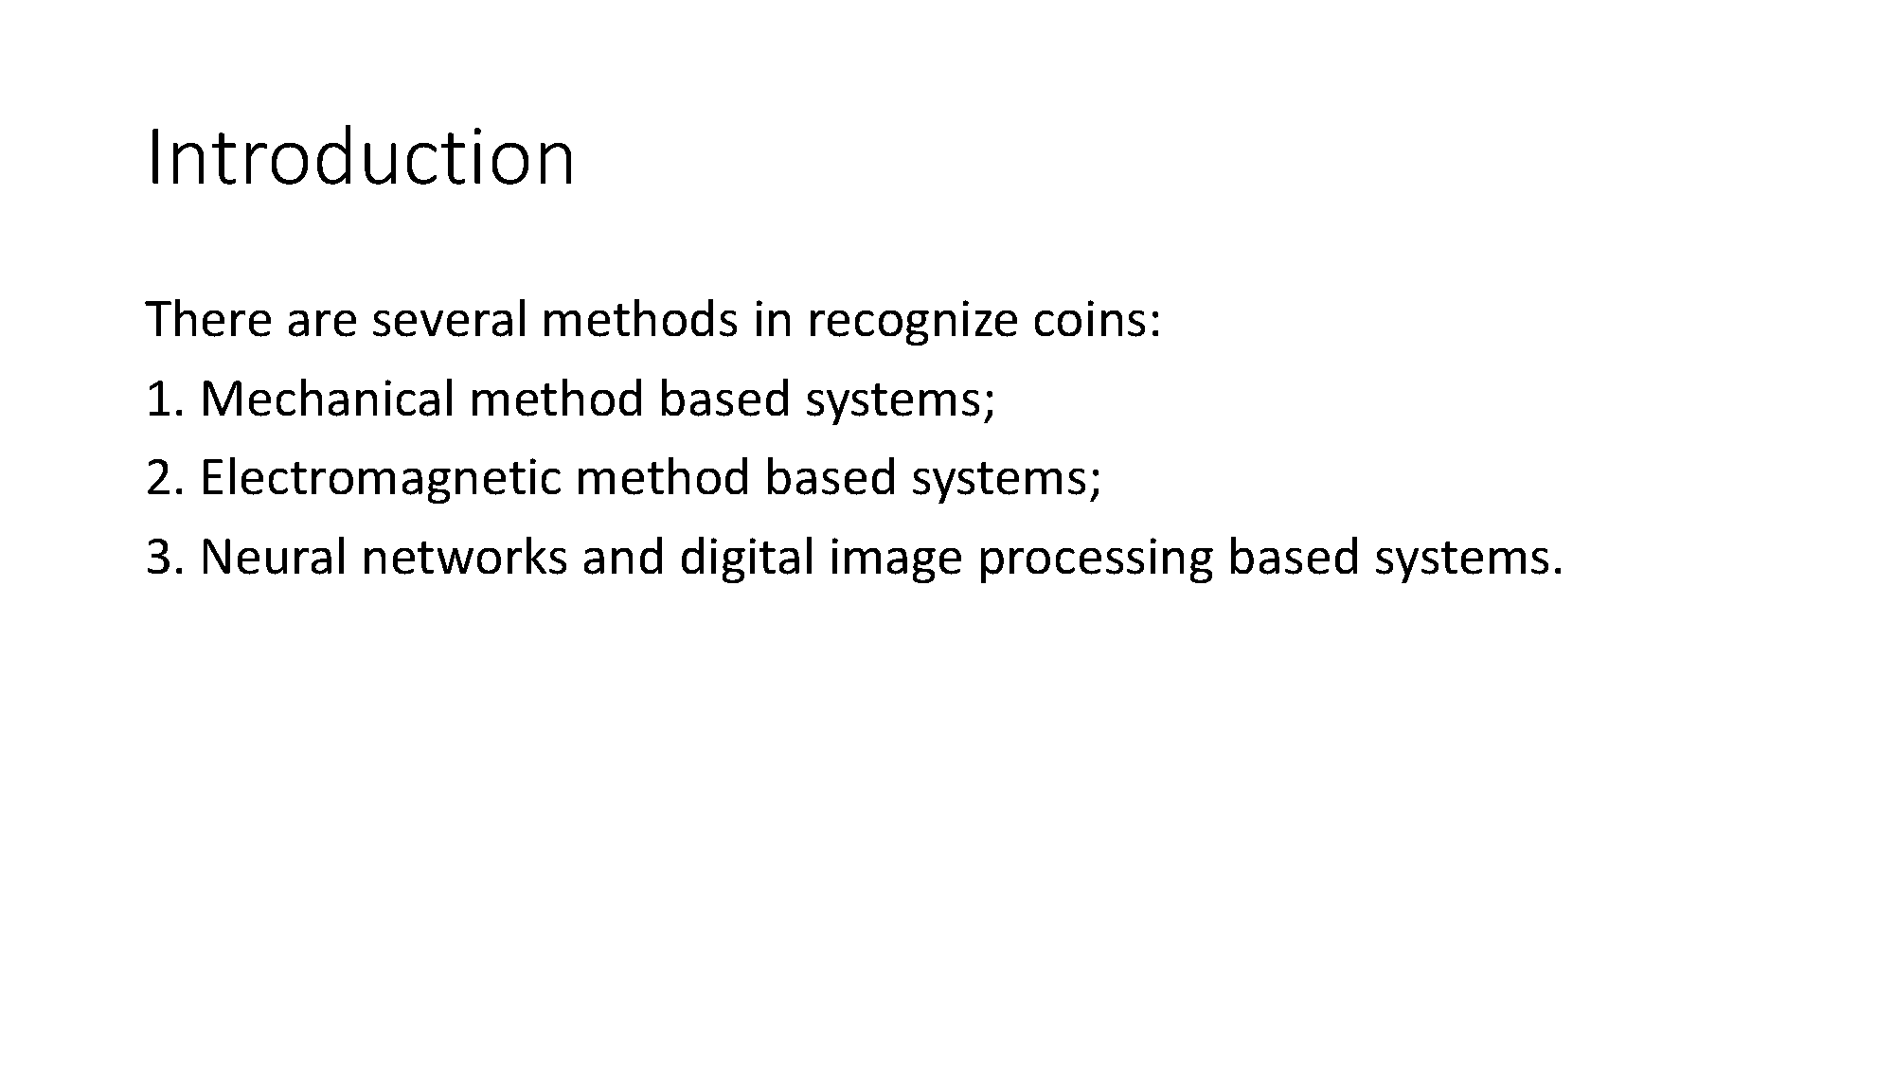

Slide 3
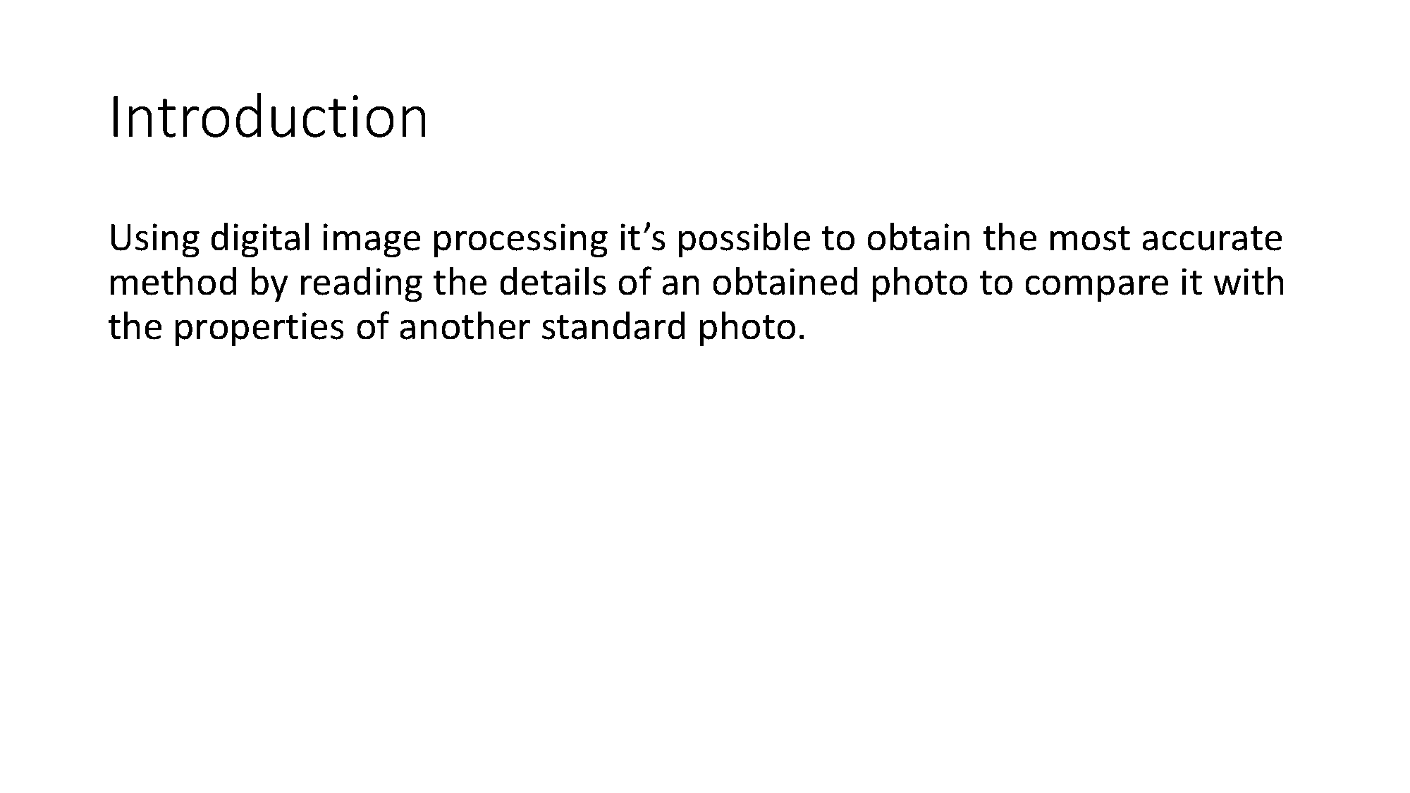

Slide 4
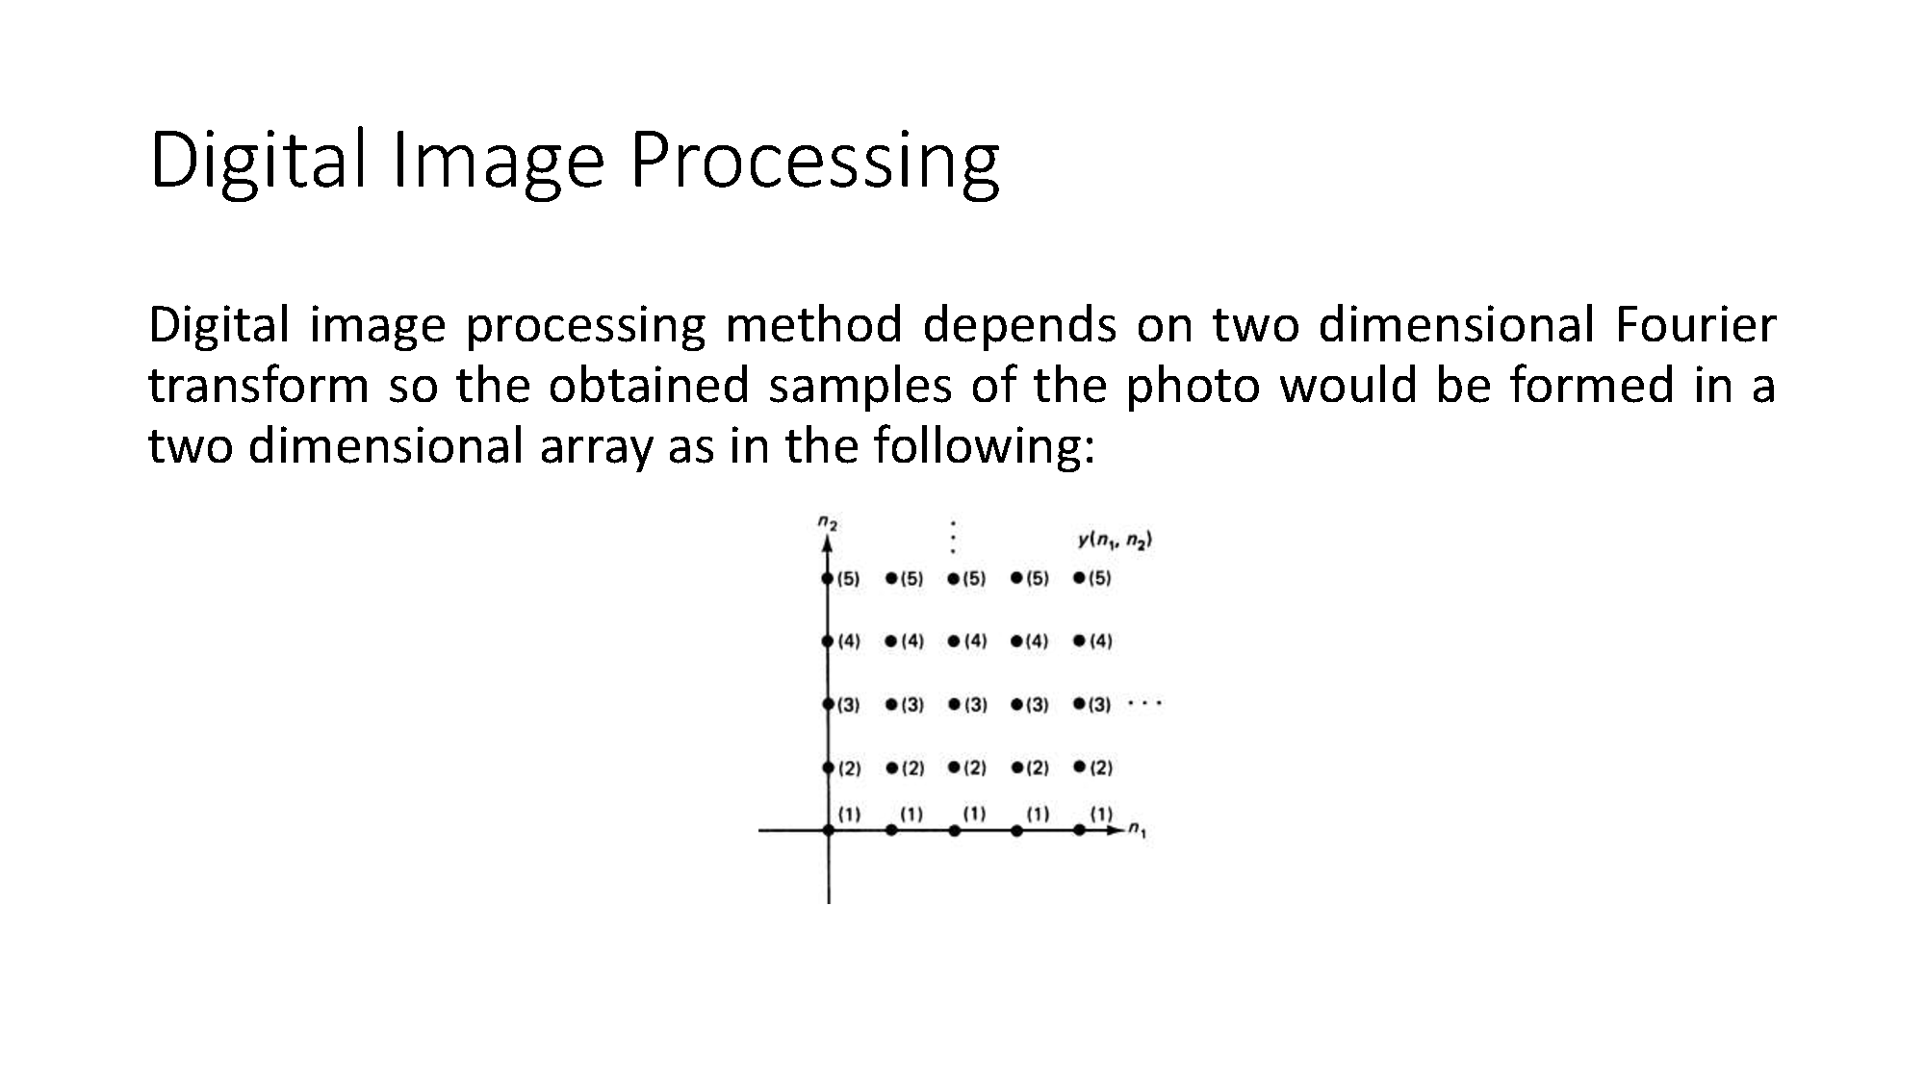

Slide 5
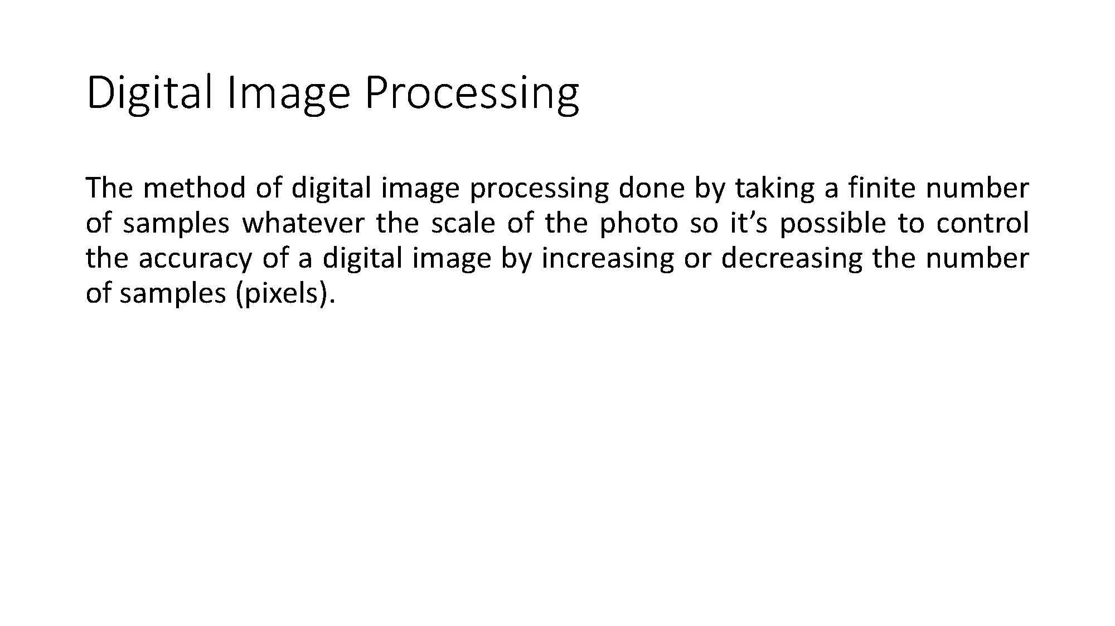

Slide 6
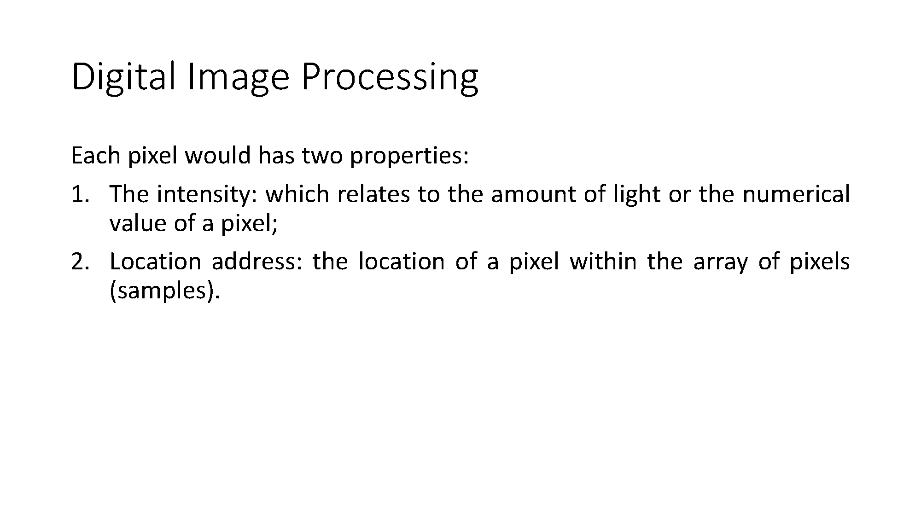

Slide 7
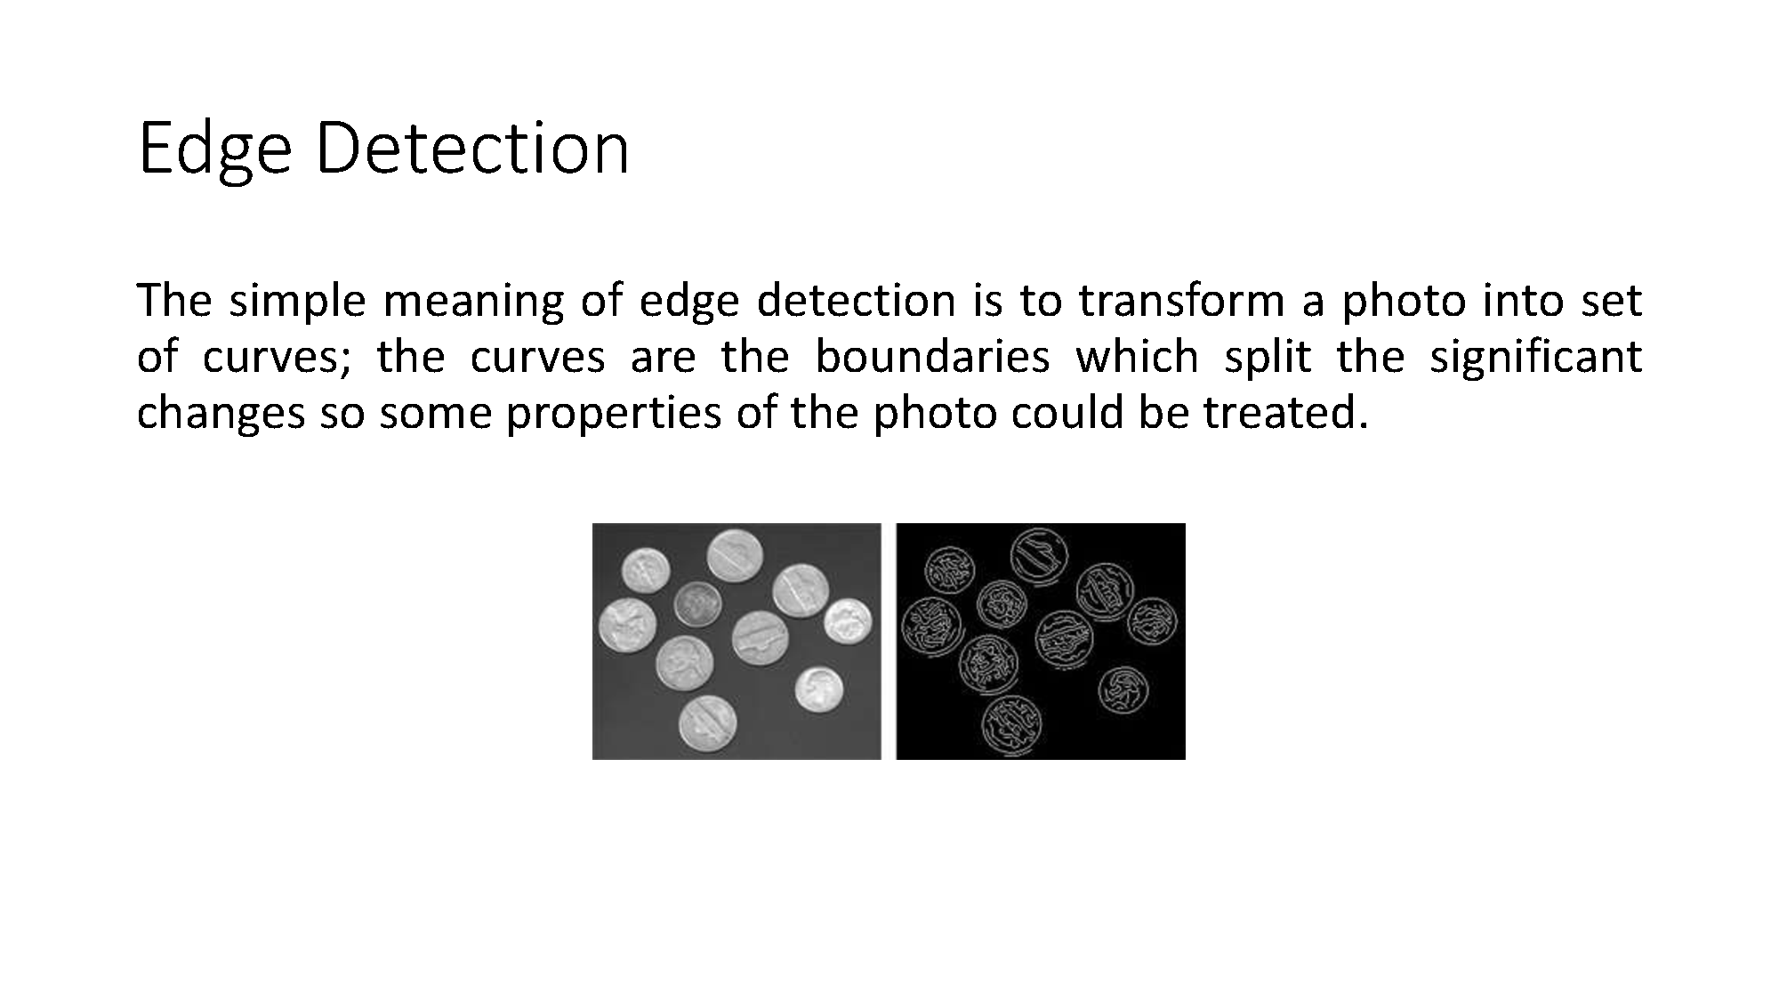

Slide 8
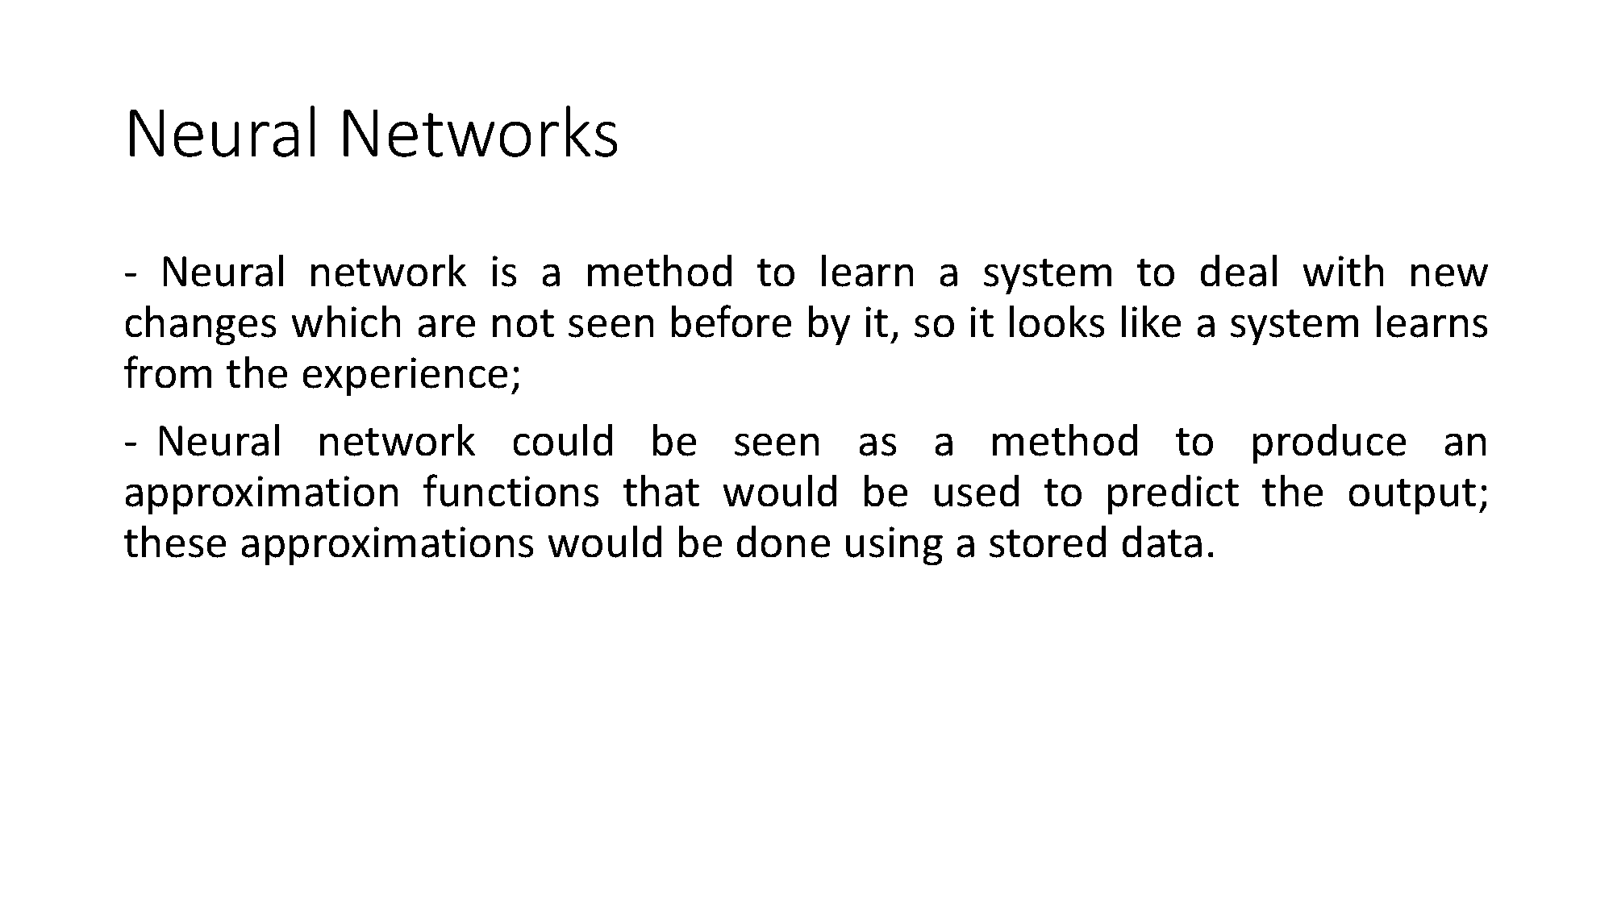

Slide 9
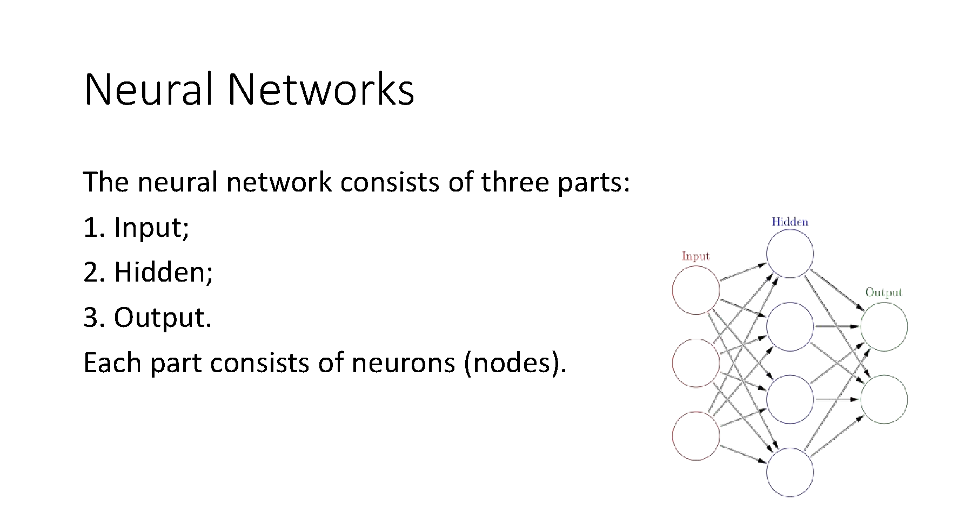

Slide 10
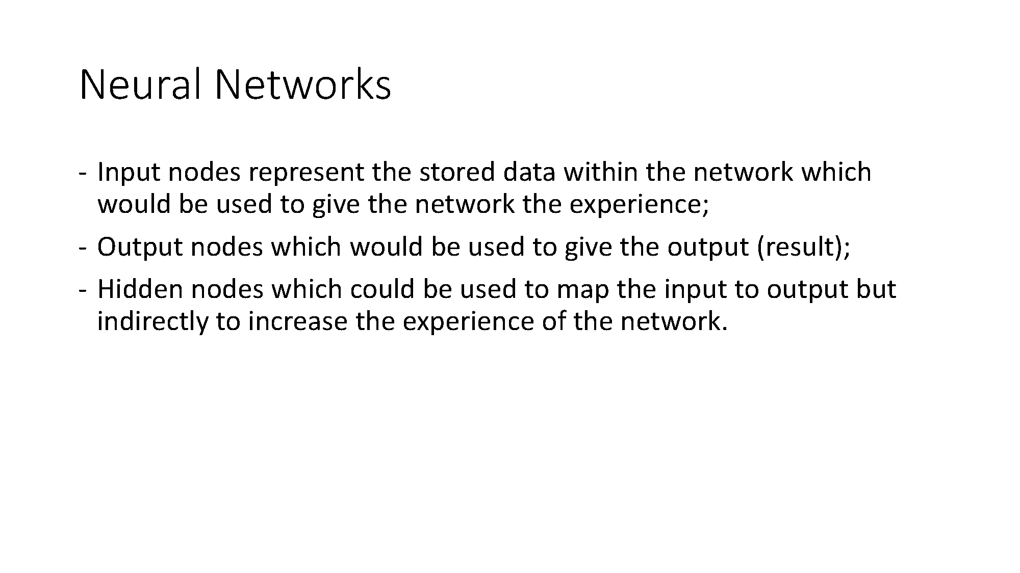

Slide 11
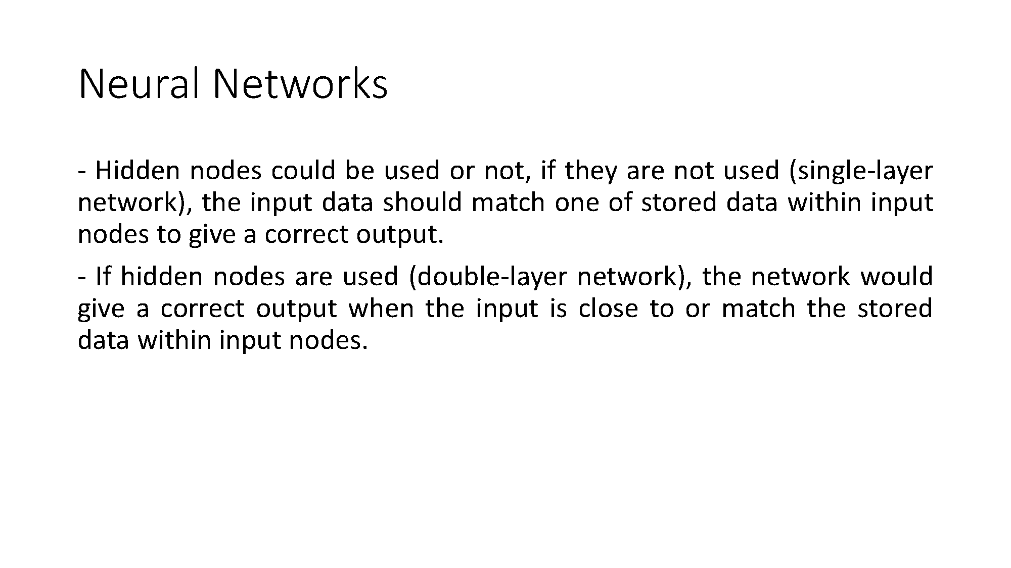

Slide 12
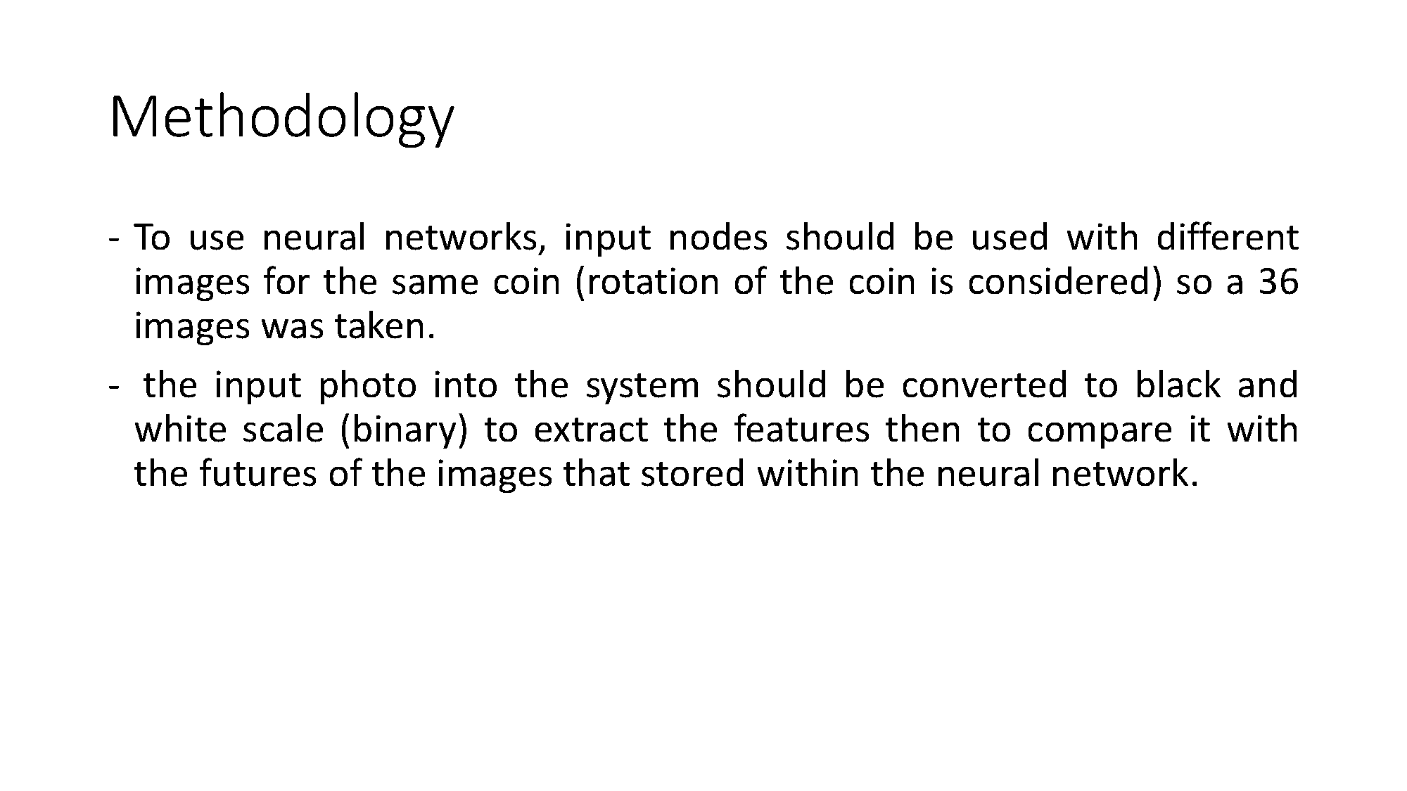

Slide 13
INPUT PARAMETERS:-
1)Input count=32040
2)Output count=7
3)Layer size=32040 20 7
4)Bias=1.0
5)Momentum=0.6
6)Learning rate=0.5
7)Max epoch count=100
8)Error threshold=0.00001
9)Batch size=169
10)Activation type=sigmoid

Slide 14
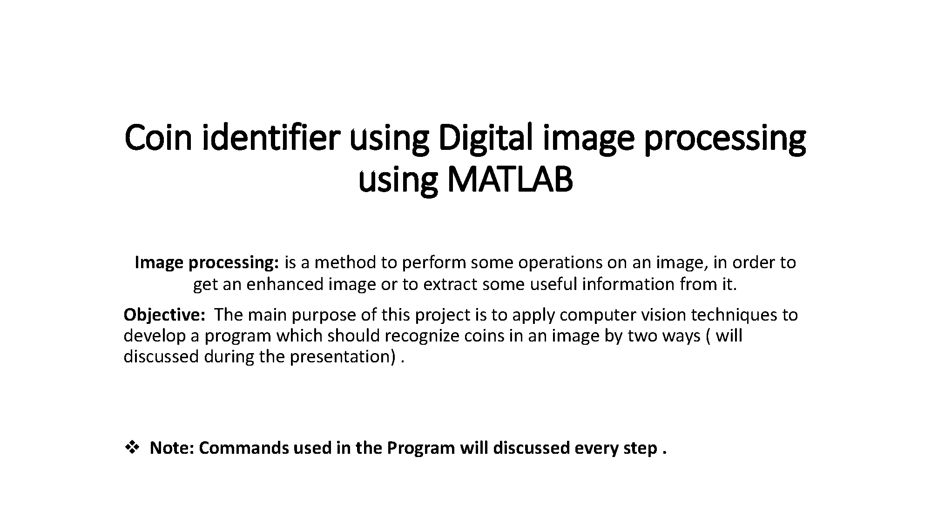

Slide 15
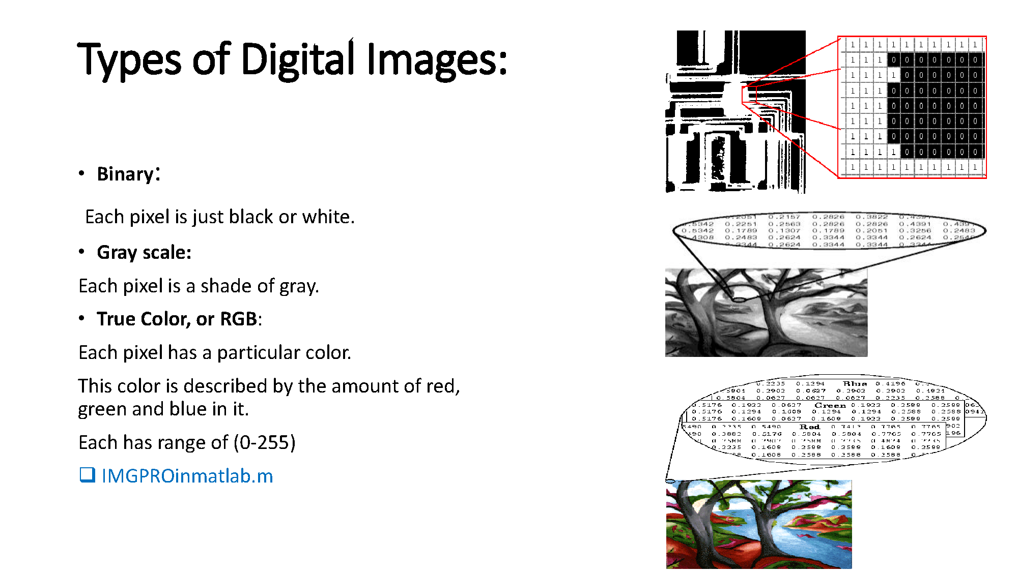

Slide 16
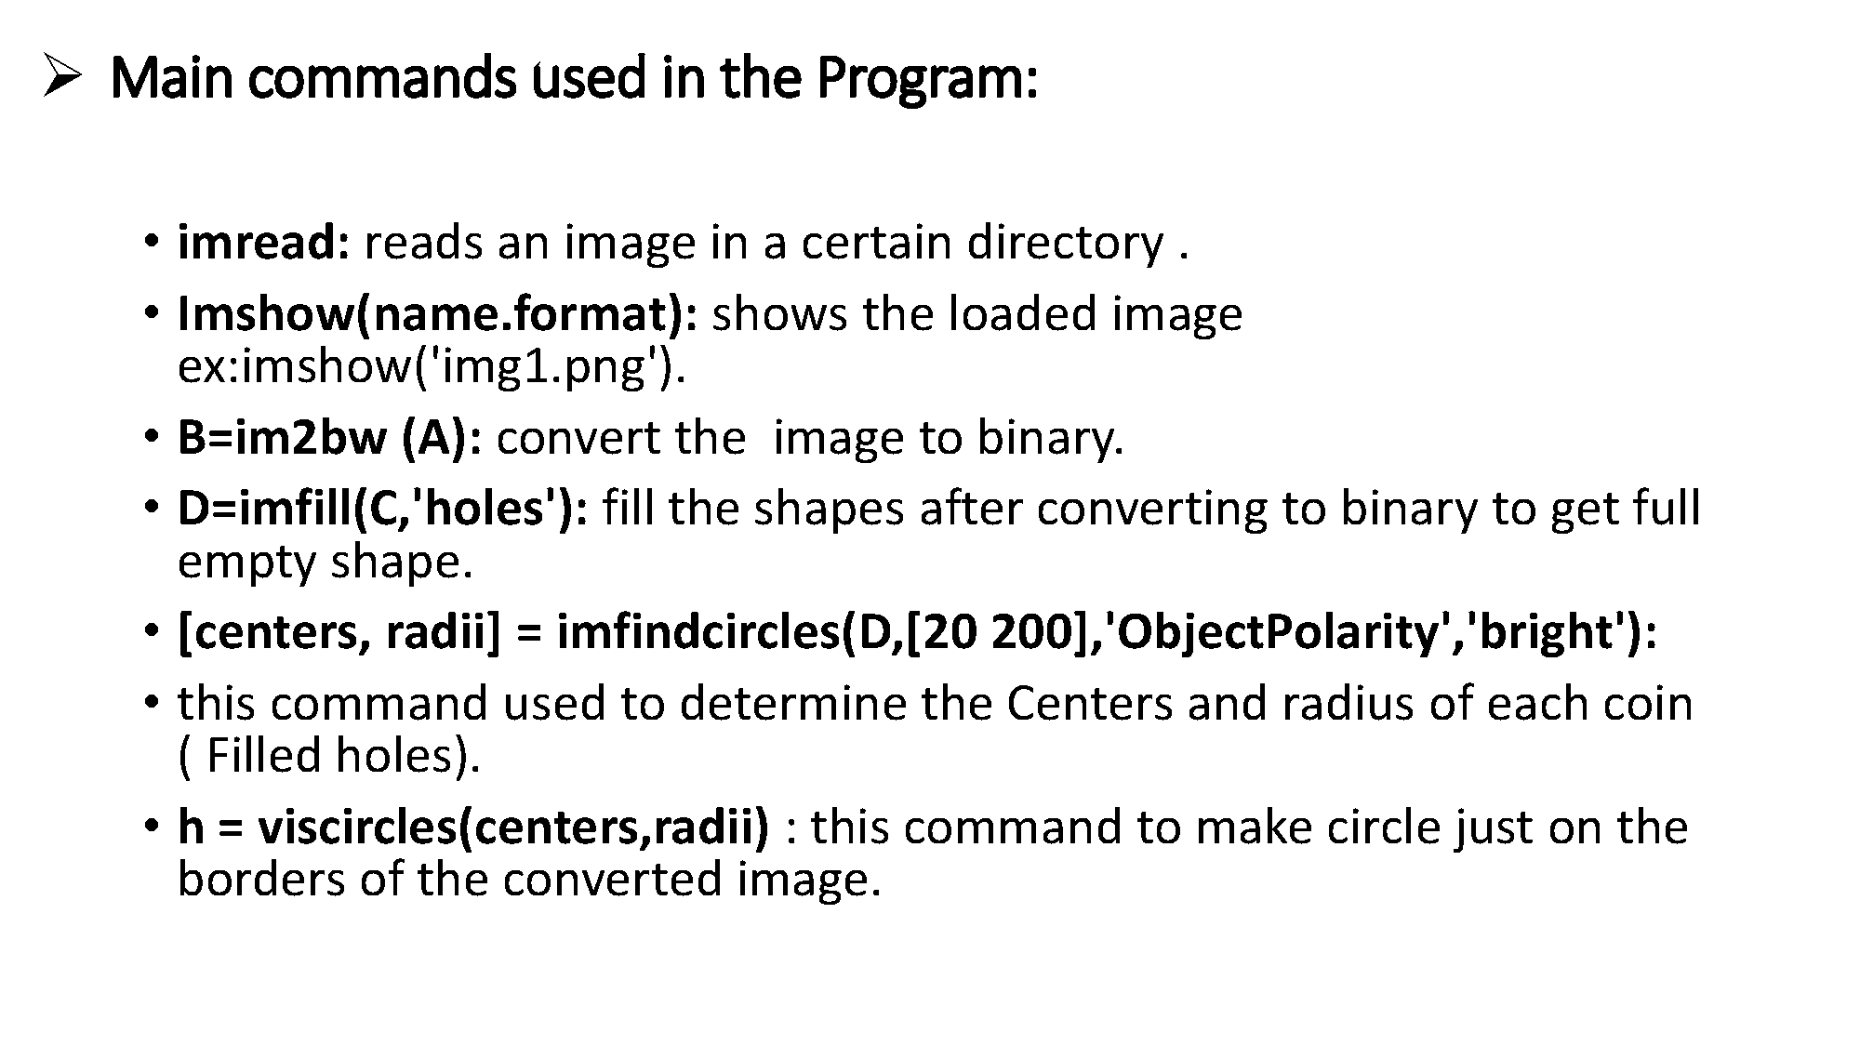

Slide 17
PSEUDO CODE:-
1: Read the coin image for creating data base
2: Convert RGB to gray scale image using ‘rgb2gray’ command
3: Convert gray image to binary image using ‘im2bw’ command (Thresholding)
4: Use ‘imfill’ command in MATLAB for removing noise from image
5: Use ‘regionprops’ command in MATLAB for determines area and centroid for coin image
6: According to area and centroid, built code for count and identification of coin
7: According to centroid and area, separate the each coin
8: End

Slide 18
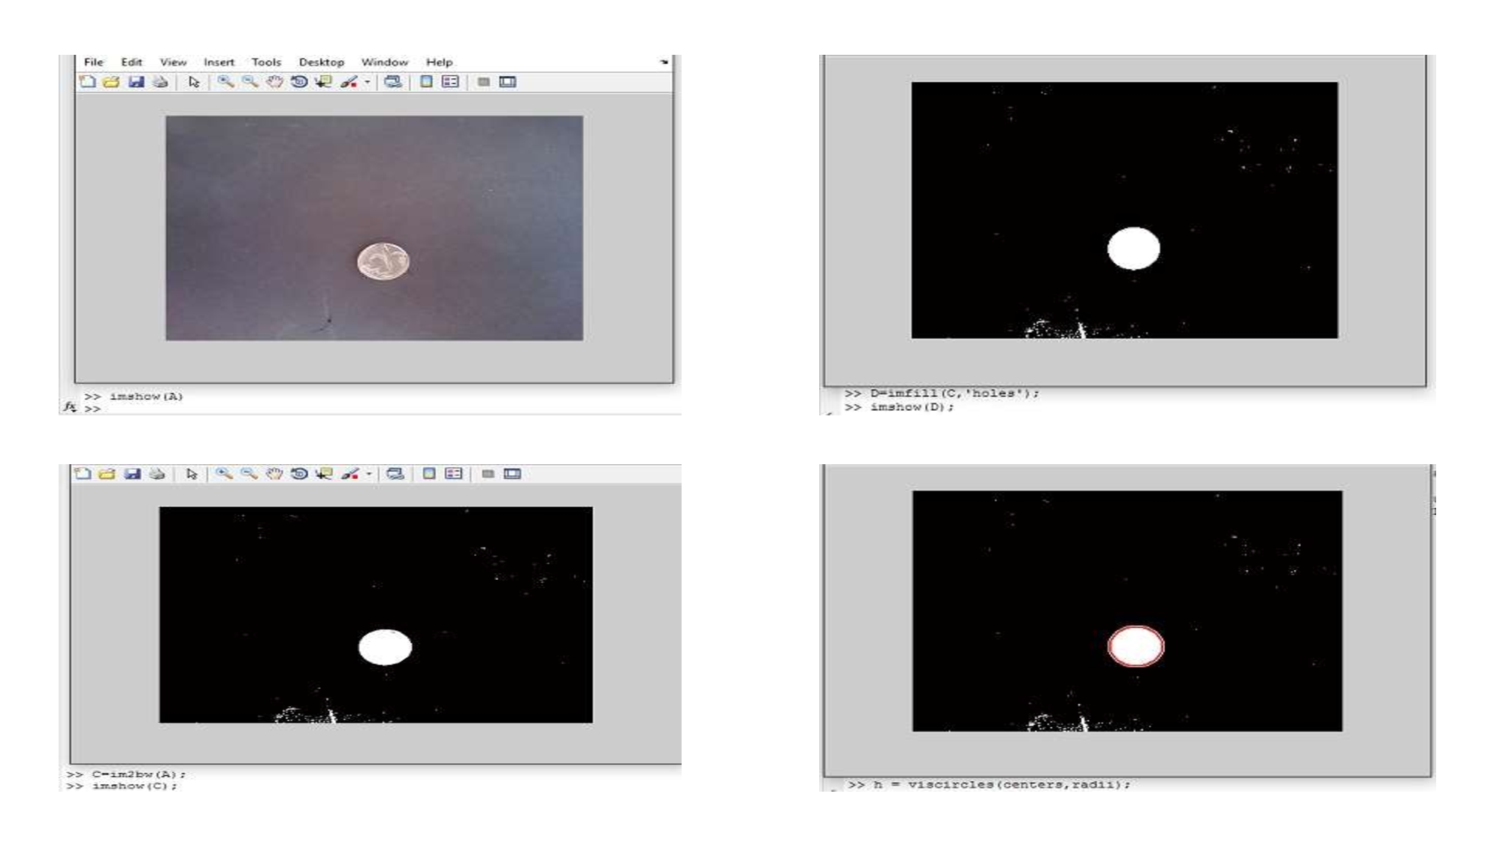

Slide 19
Data set:-
1)Computer vision labs
2)Image processing place.com
3)data.gov.in

Slide 20
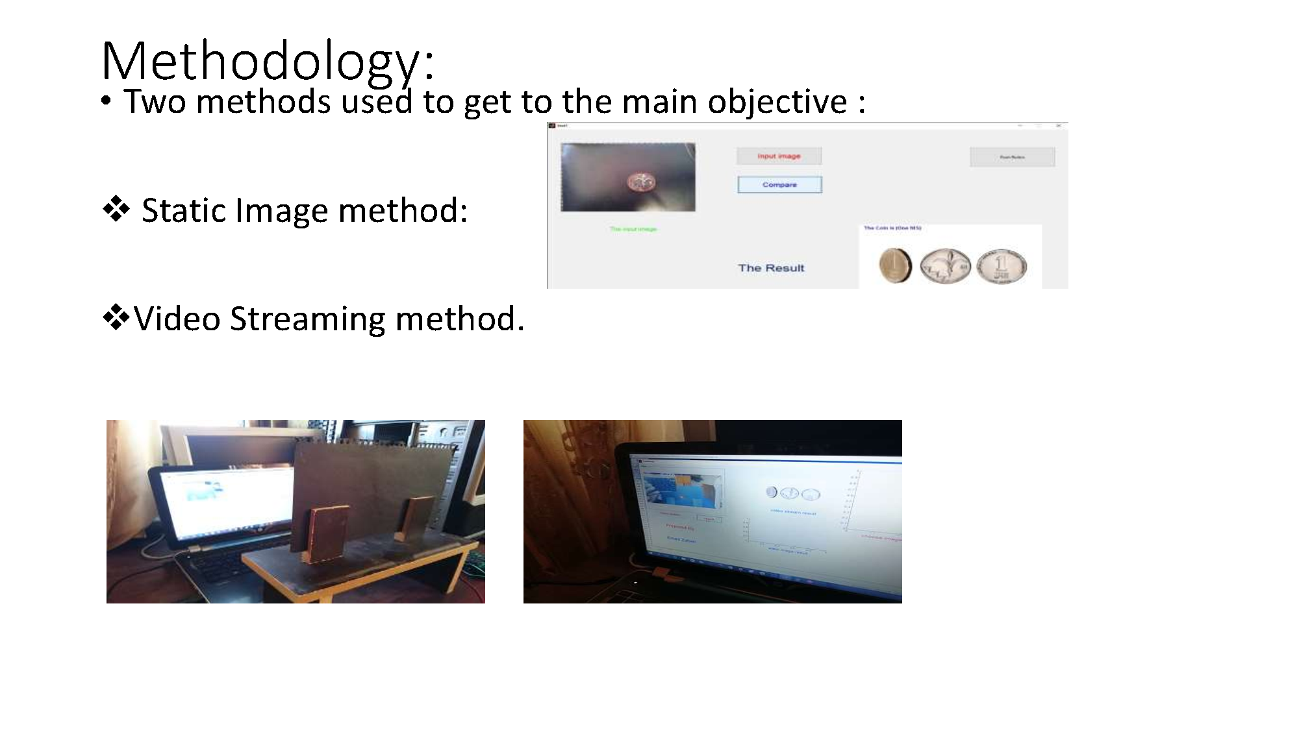

Slide 21
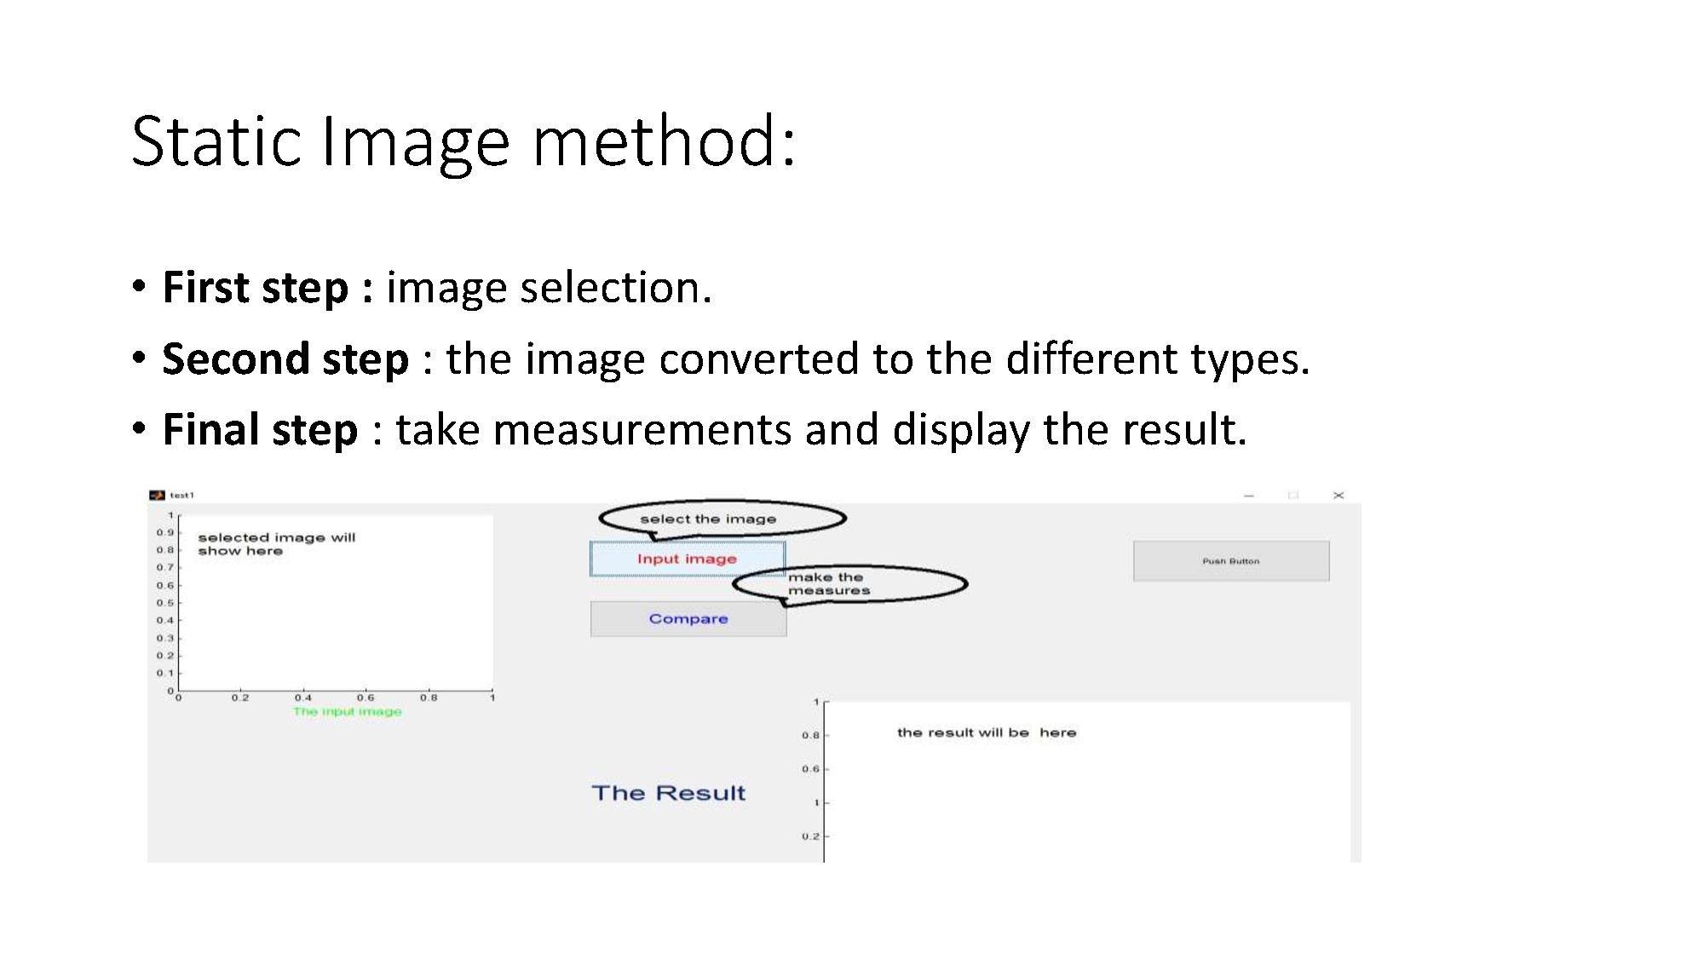

Slide 22
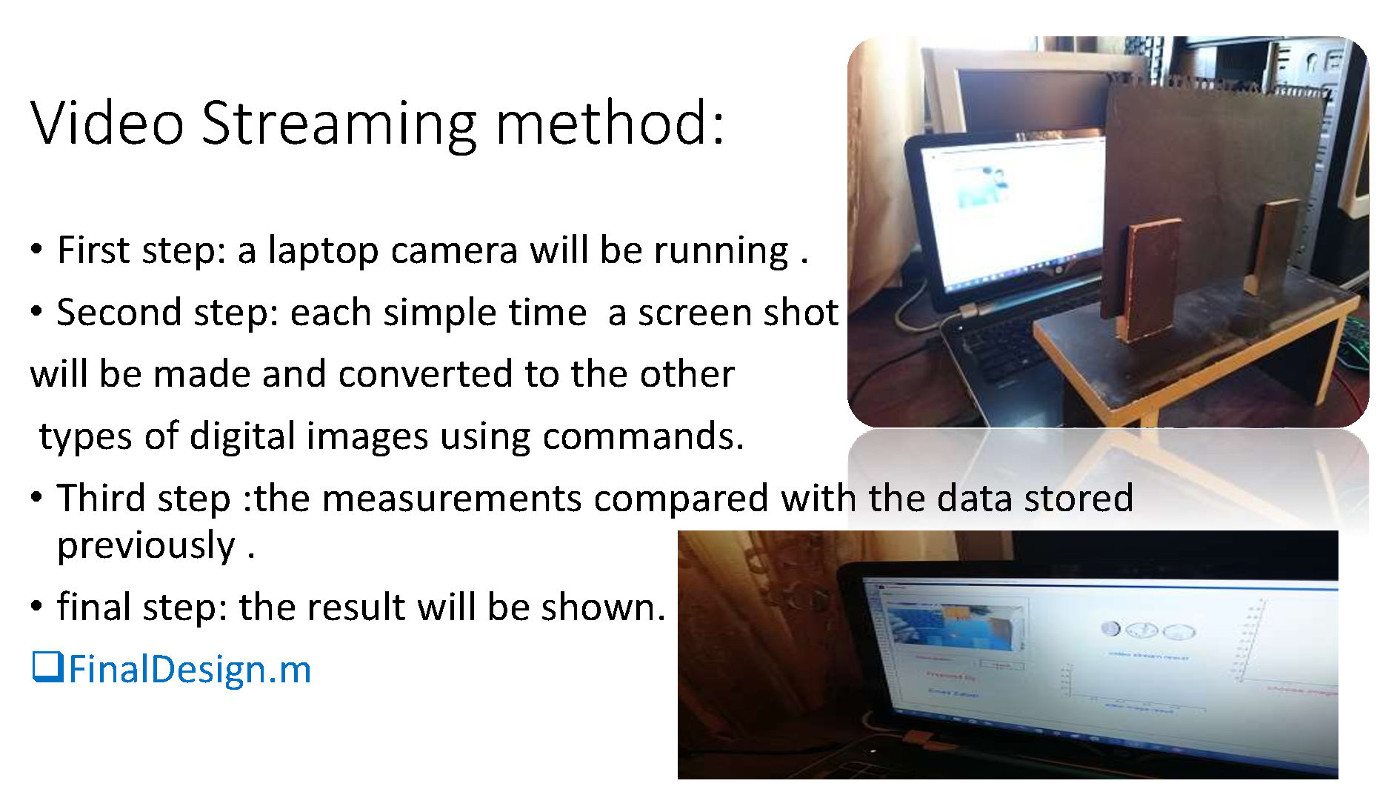

Slide 23
